Slide 1
AI Speech Intelligence System: Speech-to-Text and Summarization using Foundation Models
Ruixuan Hou
Notes:
LexGuard: 3-Minute Presentation Script
1. Motivation & System Pipeline (45s) — Manan
Visual Focus: "Motivation" (top-left) and "System Pipeline" (top-center) sections.
Script: "Good morning. We are Team LexGuard. Commercial contracts often hide high-risk clauses, such as uncapped liability or non-compete terms, that can lead to multi-million dollar disputes. Manual review is slow, often taking over 90 minutes per contract. To solve this, we built LexGuard. Our system pipeline automates the entire process: starting with PDF text extraction via PyMuPDF, followed by feature extraction, and finally automated risk detection and classification. By using AI to triage these risks, legal teams can focus on strategy rather than searching for text."
2. Dataset & Methodology (45s) — Catherine
Visual Focus: "Dataset Description" and "Methodology" sections.
Script: "Our project is grounded in the CUAD v1 dataset, featuring over 13,000 expert-labeled annotationsacross 510 legal contracts. Initially, we fine-tuned a BERT model, but our methodology evolved when we found BERT only achieved 53.8% accuracy because its small 512-token window missed long-form clauses. We replaced it with a production pipeline using Gemini 2.5 Flash. By utilizing its 1-million-token context window, we can now pass the entire document—up to 200,000 characters—in a single pass, which eliminated the context fragmentation issues we faced with traditional chunking methods."
3. System Results (45s) — Joe
Visual Focus: "Results" table and "Adversarial Stress Test" chart.
Script: "The impact of moving to full-document extraction was significant. Our production system achieved 86.3% accuracy for entity extraction. More importantly, in our adversarial stress tests, LexGuard achieved 100% hallucination prevention. While standard prompt-only LLMs often hallucinate answers when faced with tricky queries, LexGuard is strictly grounded in the contract text. This ensures that when our system identifies a high-risk clause, the legal team can trust that it actually exists in the document."
4. Conclusion & Demo (45s) — Aditya
Visual Focus: "Demo" screenshots and "Conclusion" section.
Script: "As you can see in our demo, LexGuard is a Streamlit application featuring a professional dark-themed interface. We’ve integrated Snowflake to provide persistent chat history, allowing users to reload previous sessions with all risk levels and source citations preserved. Our conclusion is clear: Hybrid RAG combined with long-context LLMs can reliably automate legal auditing at scale. Looking ahead, our next step is to build a full OCR pipeline to improve accuracy for blurry or noisy scanned contracts. Thank you for your time, and we are now open for any questions.

Slide 2
Demo & Links
Demo Video: https://umsystem.hosted.panopto.com/Panopto/Pages/Viewer.aspx?id=750a0cb7-612b-4eee-b021-b4380008d5f2
GitHub Repository: https://github.com/RHou02/quiz_c2_o1

Slide 3
Problem Description
Speech data is widely used in lectures, meetings, and daily communication. However, audio content is difficult to quickly process and understand.
This simple system builds an AI system that converts speech into text and generates concise summaries.

Slide 4
Business Value
Saves time in processing long audio recordings
Useful for meeting summarization and smart assistants
Can support education, healthcare, and customer service
Improves accessibility of spoken content

Slide 5
Datasets
librispeech_asr (main dataset), hf-internal-testing/librispeech_asr_dummy, etc.
Purpose:
Robustness evaluation
More realistic speech intelligence testing
Reduce hallucination effects
Notes:
Speaker 4 (Joe) - Results & Adversarial Testing (2:15 - 3:00)
"Finally, let's discuss our Performance and Adversarial Resilience. For our performance metrics, we achieved an outstanding 97.29% Recall for high-risk cases. Our primary design rationale was to minimize false negatives, because in public health, missing a crisis is the biggest risk. But our system's real strength is its resilience during stress testing. It successfully passed three complex traps: First, 'The Slippery Slope', where the LLM detected hidden relapse intent despite the user claiming '5 years clean'. Second, it successfully distinguished fictional dialogue in the 'Screenwriter' trap. And third, it accurately decoded street language and metaphors in the 'Slang' trap, identifying high risk even without explicit drug keywords. Thank you."

Slide 6
Models Used
Speech-to-Text: Whisper Small
Summarization: FLAN-T5

Slide 7
Pipeline Architecture
Audio Input
↓
Whisper (ASR)
↓
Transcribed Text
↓
FLAN-T5 (Summarization)
↓
Final Summary Output

Slide 8
Prompt / Input Engineering
Baseline Prompt: Simple instruction: “Summarize the text”
Improved Prompt:
• Strict constraints:
• No hallucination
• No external knowledge
• Concise rewriting
• Faithful to input

Slide 9


Results (librispeech_asr )
Here are the transcription, basline summary and improved summary.
Baseline vs. Improved: We can see baseline summary has hallucination, improved summary is more accurate.

Slide 10
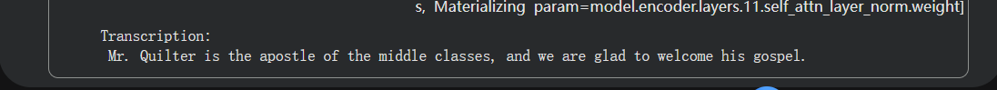
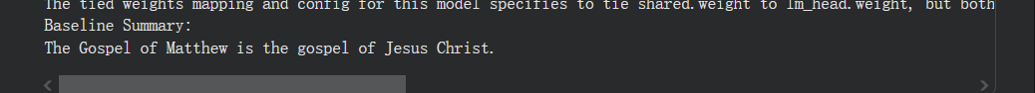
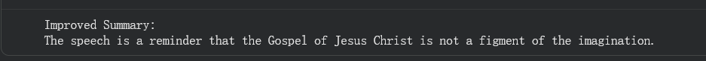
Limitations (Dataset Comparison)
I tried hf-internal-testing/librispeech_asr_dummy.
Characteristics: Very short speech samples, Low information density.
Limitations: lead to increased hallucination in summarization.
This is not due to code failure, but rather due to limited contextual information, which makes it difficult for the model to generate faithful summaries.
Notes:
Slide 2: SubstanceWatch AI Pipeline (Page 2)
🗣️ Speaker 1 (Manan) - Data Integration (0:00 - 0:45)
"Hi everyone. For this project, we developed SubstanceWatch AI, utilizing a Dual-Threshold Strategy. Looking at Stage 1, our Data Integration , we built a raw data engine using 1.1 million posts from HuggingFace and around 28,000 posts from a Kaggle mental health corpus. To ensure our models train efficiently, we utilized a stratified sub-sampling engine to create an optimized subset of 43,551 rows. This allowed us to build dense vector spaces for specific clusters like Addiction, Distress, and a Safe baseline."
🗣️ Speaker 2 (Catherine) - The ML & RAG Engine (0:45 - 1:30)
"Moving to the core pipeline. Layer 1 acts as our ML Statistical Tripwire, utilizing TF-IDF and Logistic Regression. Its primary role is to maximize recall—acting as a wide net to catch initial substance or distress keywords. Once a signal is flagged, Layer 2 engages ChromaDB Retrieval. It uses a strict L2 distance threshold to retrieve the top 3 similar historical cases. This retrieved grounding context is crucial because it prevents the LLM from hallucinating in the next step."
🗣️ Speaker 3 (Aditya) - The LLM Evaluator (1:30 - 2:15)
"In Stage 3, we generate an Explainable Output. Layer 3 is our Final Evaluator, powered by the Gemini 2.5 LLM. It performs deep internal analysis to distinguish between active crisis signals, like current cravings, and benign text like retrospective recovery stories or podcast promotions. The system then outputs a final AI assessment, such as 'Low Risk', completely backed by a risk summary and supporting evidence with direct quotes from the user's text."

Slide 11
Tools Used
Hugging Face Transformers for accessing and running pretrained models
Whisper (by OpenAI) for speech-to-text transcription
FLAN-T5 (by Google) for text summarization
PyTorch for model inference and tensor operations
Google Colab for implementation and execution environment

Slide 12
Insight
Over-compression leads to incomplete outputs
Balanced prompts produce the best results
Model behavior is sensitive to instruction wording

